Slide 1
Showcase: Galiano & Penelakut Islands, Their current & historic Vulnerability
Ms BT’s Literary Studies 11
Culture and Identity Lesson: BC’s Gulf Islands
Penelakut Island used to be known as Kuper Island

Slide 2
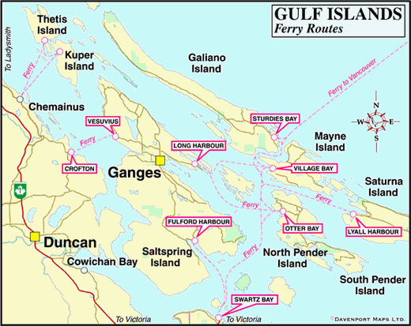
The Geography of Galiano and Penelakut Island
Galiano and Penelakut (Kuper) islands are close in proximity and share a sensitive history.
Penelakut Peoples lived on Penelakut (Kuper) Island as well as northwest Galiano Island

Slide 3
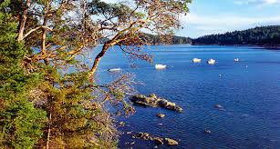
1863 Galiano and Penelakut
•Henry Georgeson moved to Mayne and manned the first lighthouse.
•Most settlers built on the south end of Galiano island.
•Settlers would row across Active Pass to Mayne for mail, church services, and social drinking.
Today people still enjoy going to Galiano to bike, kayak, and hike the ocean side trails.

Slide 4
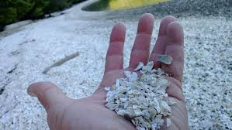
Galiano Island Museum – History
•There are records of the Coast Salish First People having camps at Galiano Island.
•A delicate and beautiful environmental aspect of Galiano is that it is the host to an extensive shell middens at Montague Harbour that is over 3,000 years old.
•The traditional territory of Hul’qumi’num speaking populations resides on Kuper/Penelakut Island, a short boat ride away from Galiano.
•When the European colonists arrived, the First Nations openly embraced the European colonists’ religion and technology.
The shell middens at Montague is an environmental beauty enjoyed by environmentalists and the general public

Slide 5
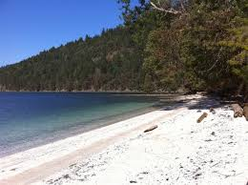
Galiano History continued
•Part of the history of the colonial integration and take over in BC is that the First Nations were already decimated in the 1780s by a small-pox epidemic, brought by the European settlers.
•In the late 1800s, because of the sickness and other problems, the Lamalchis First Nations tried to resist the power of the European settlement.

Slide 6
Kuper/Penelakut Island
General Order of Events:
•In 1851, British sailors surveying the area cruised into a tiny group of unnamed islands, naming the two largest: Kuper and Thetis Islands
•In 1863, a British naval gunboat attacked a First Nations village on Kuper Island.
•In response, a fierce battle with a handful of warriors yielded a great defeat for the “Canadian” colonial government.
•After this defeat, the colonial government responded with the largest military operation throughout island waters : the “Lamalchi War. As part of their retaliation, the First Nations’ village was brutally shelled and their warriors hunted down like dogs and hung. They were dispossessed of their lands by military might.
•In 1890, Kuper Island Residential School was opened. It was mandatory that all Coast Salish children enroll.
•Since the Reconciliation Committee has helped BC to recognize their wrong doings, as of 2010 Kuper Island is now named Penelakut Island to acknowledge the Penelakut People.

Slide 7
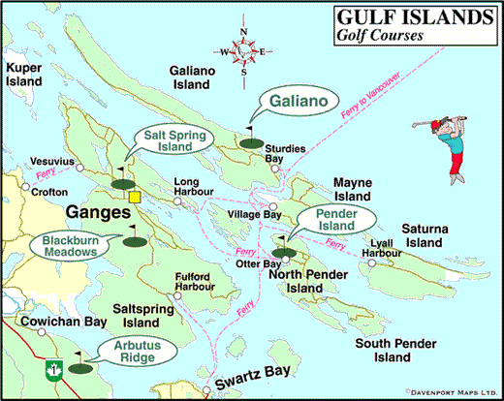
Galiano’s neighbouring island, Kuper Island
•Part of the unfortunate history of Galiano and the surrounding area is that Kuper Island was previously home to a Residential school (1890) where hundreds of Coast Salish children were forced to reside. Many of the children tried to escape by floating on logs along the four mile stretch of water. The residential school was closed down in the mid 1970s.
At Kuper Island Residential School, Coast Salish children were striped of their traditional clothing, hair style, language, and traditional ways of learning and living.

Slide 8
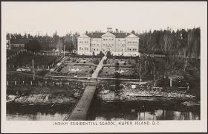
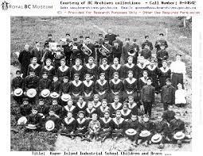
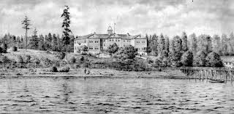
1890 Kuper Island Residential School
Original images of Kuper Island Residential School.
Many of the Coast Salish children tried to escape by floating on logs along the four mile stretch of water.

