Slide 1
James Driver’s Ed FR Essay!
James is in a Driver’s Ed course preparing for his test. This course includes both book work and driving on the road to prepare students for a written test and a road test.
•Describe how each of the first 4 terms might influence his ability to drive a car during the road test.
•Describe how each of the remaining 3 terms are related to the results of the written test.

Slide 2
Describe how each of the first 4 terms might influence James’ ability to drive a car during the road test. •Describe how each of the remaining 3 terms are related to the results of the written test.
Influence James’ driving
Cognitive map
Cerebellum
Observational Learning
Human Factors
Relate to the written test results
Reticular Formation
Predictive Validity
Semantic Memory

Slide 3
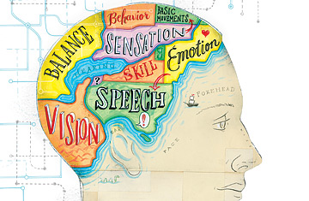
Cognitive Map – is an organizational web
James’ mental model guides how he first steps on the clutch, then gives a little gas, then eases off the clutch, and lastly gives more gas to proceed from first to second gear as he drives.

Slide 4
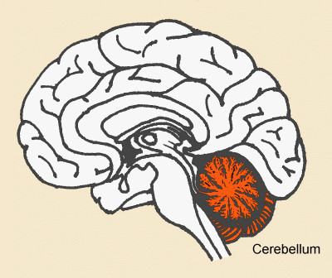
Cerebellum – is the region in hindbrain that plays in motor control
James’ cerebellum is working well and he is able to coordinate his left foot and the clutch along with his right foot and gas pedal to gear up and down as he drives.

Slide 5
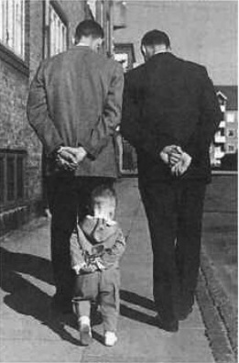
Observational Learning – is viewing one person’s behaviour and then mimicking it
James has seen the method his father takes while he parallel parks; as James drives he follows all his father’s procedural steps and perfectly executes parallel parking.

Slide 6
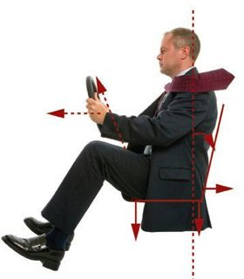
Human factors – are the ergonomics and workplace safety; it is designing products and focusing on the safety of the user
James has a car that is small and difficult to easily access the gas pedal; he reaches for the pedal and the design and space factors interfere and he misses. This causes the car to lurch and stall.

Slide 7
Reticular formation – is the brainstem area involved in filtering incoming stimuli
James has a healthy reticular formation and this allows him to stay alert while he writes it; as well he does not fall asleep as he completes the test. After it is marked, he hears the words “You passed”
PLEASE
PAY ATTENTION

Slide 8
Predictive validity – when the criterion measures are obtained at a time after a test; tests with predictive validity are career and aptitude tests
If James gets 100% on his written test, the prediction is that James’ car driving should be “good” or he will be “not a bad” car driver; if he is a poor driver, then the test doesn’t have predictive validity

Slide 9
Semantic Memory – Explicit memory; memory for the meaning of words, facts, names and general knowledge information
When James takes the written test and his semantic memory is functioning well, he will see the phrase “breaking distance” and remember that it means the distance it takes it stop from a certain speed. He knows that he needs to apply pressure to the brake pedal.
Remember!!!

